Slide 1

232,112,113
64,64,64
2
0
2
0
Senarios of Final-001
汇报人：0184411-殷鹏飞 时间：2020年04月

Slide 2
目录
01
02
03
04
Scenario description
Q & A
For diner
For staff
延迟符

Slide 3
01
Scenario description

Slide 4
Scenario description
Scenario 7
A catering company tries to open a free waiter/waitress restaurant. The restaurant wants to add a new tablet on the table and install software which can help the client do the order themselves on the tablet. The client should be able to view all the dishes on the menu and order the dishes and alcohol as they wanted. They also should be able to check if the dishes have been made so if they decide to change or retreat a dish. There are also dish dispatchers who can constantly change and check the state of ordered dishes. The cashier can check the payment of each table and the discount according to client’s VIP card. The manager should be able to check the turnover of every month.

Slide 5
02
Q & A

Slide 6
Q & A
Question 3
Suppose that you have finished your milestone 1.0, design a presentation of the system to the manager and employee of the restaurant. 殷鹏飞
Answer for milestone 1.0
Milestone 1.0 is an intelligent management system tailored for restaurants based on Internet of Things and cloud computing technology. It can significantly save the number of employees, reduce operating costs and improve management performance through guest self-ordering system, service call system, back kitchen interactive system, front desk cash register system, reservation and numbering system and information management system.

Slide 7
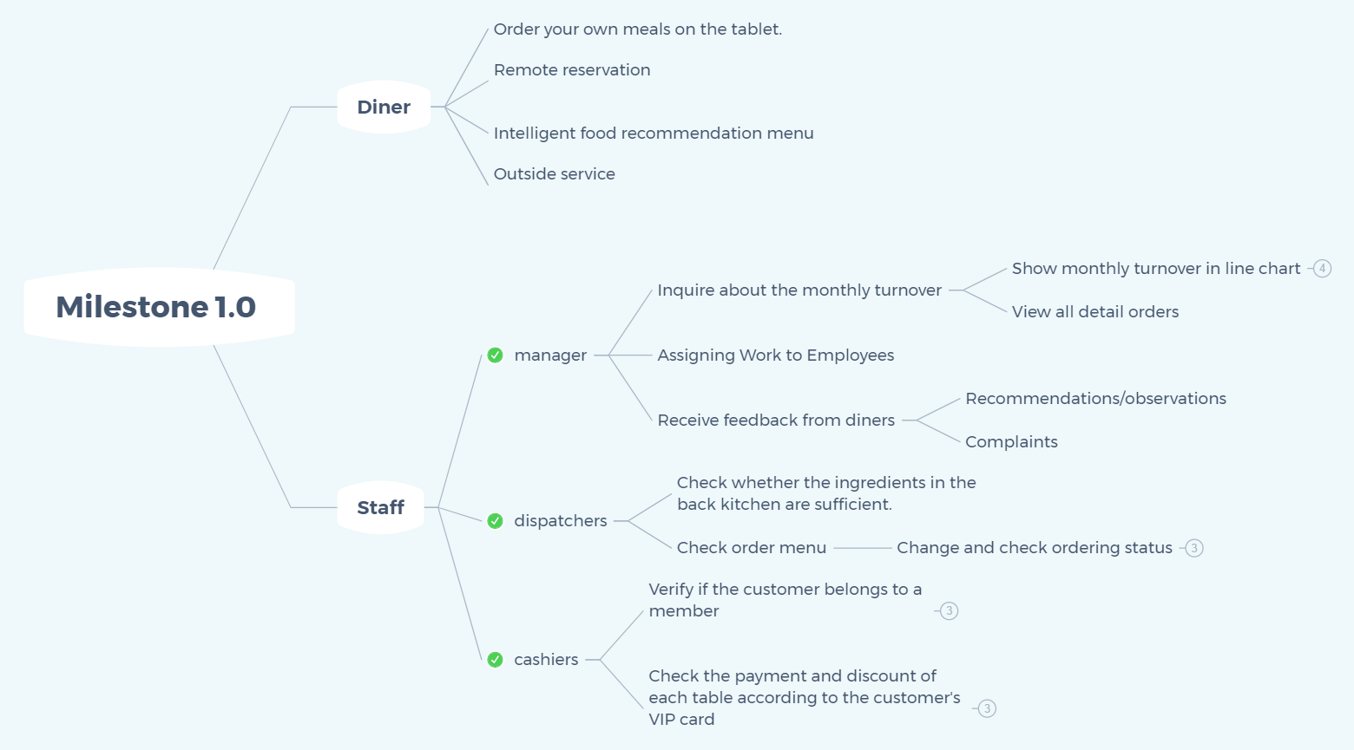
Q & A
Functional map

Slide 8
03
For customer

Slide 9
For customer
1. Order your own meals on the tablet
2. Remote reservation
3. Based on big data mining diners' consumption trajectory and consumption patterns, custom menus are generated for diners
4. Outside service

Slide 10
For customer
Diners can order their own meals and can sort and choose according to the click rate and score of past diners.
Diners can reserve seats through the Internet or telephone, queue up remotely to pick up numbers, and order in advance. When calling merchants, the cloud-based CRM system can help merchants identify customers' identities and consumption habits, thus helping merchants to provide higher quality services.
Based on the consumption trajectory of diners, the consumption pattern of diners is mined and the consumption demand of diners is predicted. According to the diner's taste, preference and consumption ability, and in combination with the diner's position, push some food to the diner.
The system reminds diners to queue while Shopping, or order in advance while queuing, thus effectively utilizing the queuing time.

Slide 11
04
For staff

Slide 12
For staff
1. For manager
2. For dispatchers
3. For cashiers
4. . . . . . .

Slide 13
For staff
For manager
1. Check the monthly turnover.
2. Assign various tasks to employees in the system to facilitate employees to work efficiently.
3.View VIP member users and their membership grades.
4. Accept feedback from users, such as suggestions for improvement of dishes and reports from diners.

Slide 14
For staff
For dispatchers
1. Check whether the food materials in the back kitchen are sufficient.
2. Assign specific areas to which waiters are responsible.
3. Have the right to modify the menu appropriately according to customer requirements.

Slide 15
For staff
For cashiers
1. Verify if the customer belongs to a member
2. Check the payment and discount of each table according to the customer's VIP card

Slide 16
Summary
Milestone 1.0' s system interface is simple and easy to operate, with powerful functions. It solves many painful problems of merchants and diners. We believe this system will soon set off a revolutionary wave of catering management.

Slide 17
232,112,113
64,64,64
2
0
2
0
Senarios of Final-001
汇报人：0184411-殷鹏飞 时间：2020年04月
THANKS

